Slide 1
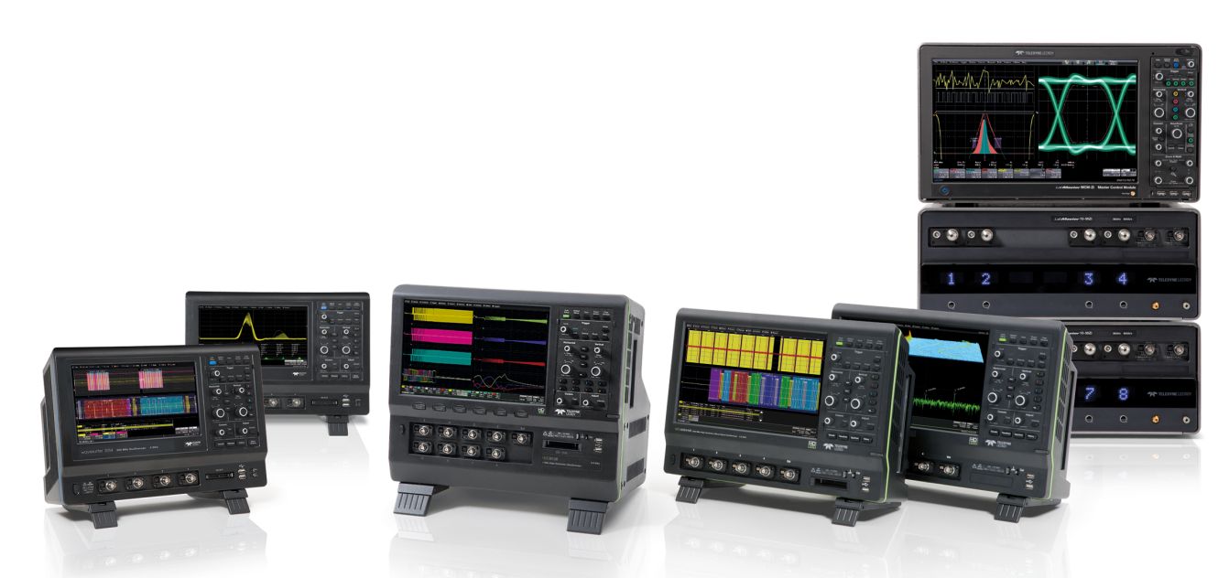
Oscilloscope Basics
What my digital storage oscilloscope can do!

Slide 2
Table of Contents
Basic Setup of a Digital Oscilloscope
Analogue and Digital Bandwidth
Memory
Signal Sampling
Display
Trigger
Measurement (Cursor, Parameter)
Math
Automatic Signal-Evaluation
Documentation

Slide 3
Basic Setup

Slide 4
Basic Setup of a Digital Oscilloscope
ACQUISITION
DOCUMENTATION /
COMMUNICATION
ACQUISITION
Input Amplifier
Analog/Digital Converter Acquisition Memory
Trigger-Logic
Time Base
DISPLAY
Display Processor
Display Grid
MESSUNG/ANALYSE
Processor
Math Co-Processor
Processor Memory
DOCUMENTATION
Hard Drive(s)
USB-Stick
Interfaces
CH 1
ANALOG-
DIGITAL-
CONVERTER
FAST ACQUISITION MEMORY
INT. HARD DRIVE
CH 2
ANALOG-
DIGITAL-
CONVERTER
FAST ACQUISITION MEMORY
EXT. HARD DRIVE
USB STICK
LAN
EXT.
TRIGGER
TRIGGER LOGIC
TIME BASE
RS-232C / GPIB
REAL TIME CLOCK
FRONT PANEL
CH 3
ANALOG-
DIGITAL-
CONVERTER
FAST ACQUISITION MEMORY
MEASUREMENT &
ANALYSIS
MAIN PROCESSOR
MATH. COPROCESS.
CH 4
ANALOG-
DIGITAL-
CONVERTER
FAST ACQUISITION MEMORY
PROCESSOR-MEMORY
PROGRAM &
MATH / ZOOM
SIGNAL DATA
DISPLAY
PROCESSOR DISPLAY

Slide 5
Bandwidth & Memory

Slide 6
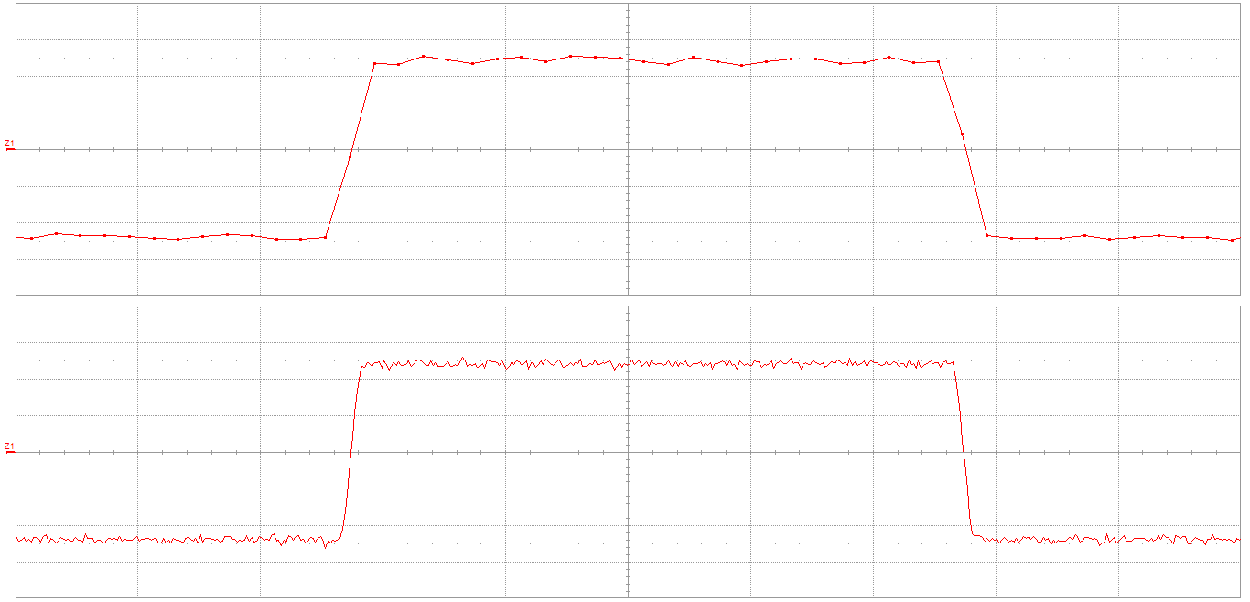
Analog and Digital Bandwidth
Analog Bandwidth
  Bandwidth of the analog amplifier
Digital Bandwidth
  Depends on the real time sampling rate
  Frequency response of the analog/digital converters
  Memory depth and sampling rate define the time that can be captured
5 MHz rectangle,
250 MS/s
5 MHz rectangle,
2.5 GS/s

Slide 7
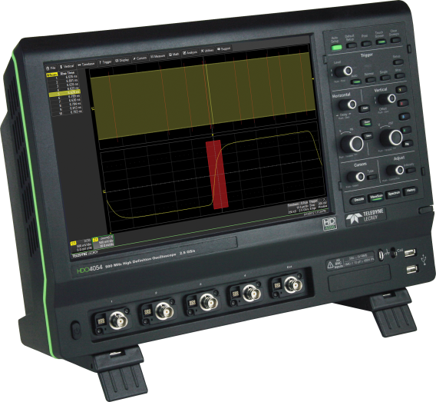
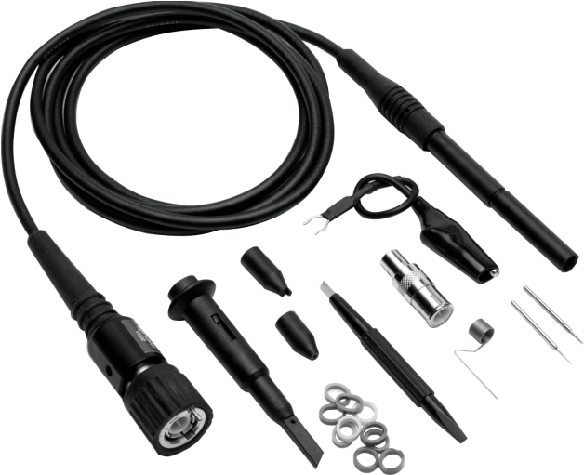
Analog Bandwidth – System
Bandwidth of the analog amplifier
Higher frequencies do not reach the ADC
  Wrong signal shape or no signal display at all
Bandwidth ⇒ Probe + Oscilloscope !

Slide 8
Polling Question #1
What Bandwidth(s) Are You Mainly Using?
  < 100 MHz
  100 – 500 MHz
  500 MHz – 1 GHz
  > 1 GHz

Slide 9
Memory
Acquisition memory for Signals
  Specification in points ('pts') ⇒ e.g. '20 kpts' = 20'000 measured values
Memory per Channel or Interleaved Memory
  Memory combination when few channels are used
  ⇒ 12.5 Mpts per channel (4 channels) / 25 Mpts per channel (2 channels)
Memory Defines the Maximum Sampling Rate for the acquisition time
  1 GS/s sampling at 1 Mpts memory
  1'000'000 measured values / 1'000'000'000 measurements/s = 0.001 s or 1 ms
Memory Segmentation / Sequence Mode
  Fast signals with long signal pauses
  Optimization of memory use

Slide 10
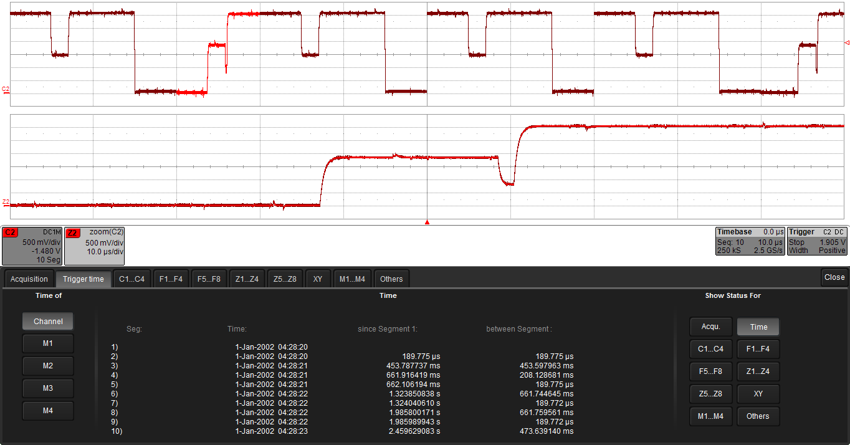
Memory Segmentation
Efficient and
intelligent memory
use
Memory division into
to 10'000+ segments
Up to 1.25 million
acquisitions/s
Capturing fast
events with long
pauses
Table with time stamp for every segment for clear allocation

Slide 11
Sampling

Slide 12
Sampling
Real Time Sampling
  Standard mode in oscilloscopes
  Individual sampling
  Transient signals
  Dependent on the time base and number of channels (interleaved sampling)
  Problem of aliasing
Random Interleave Sampling or Equivalent Time Sampling
  Multisampling
  For periodic signals with a stable trigger time only
  High effective sampling rates are possible
Roll Mode
  Slow signals

Slide 13
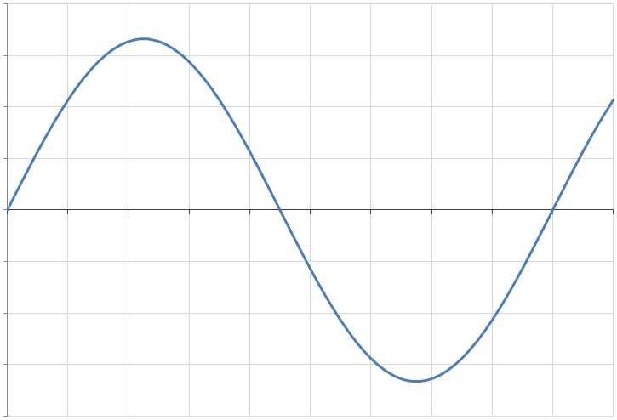
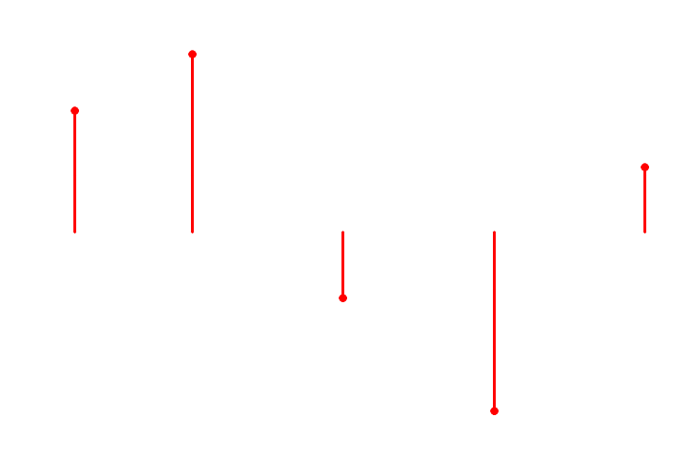
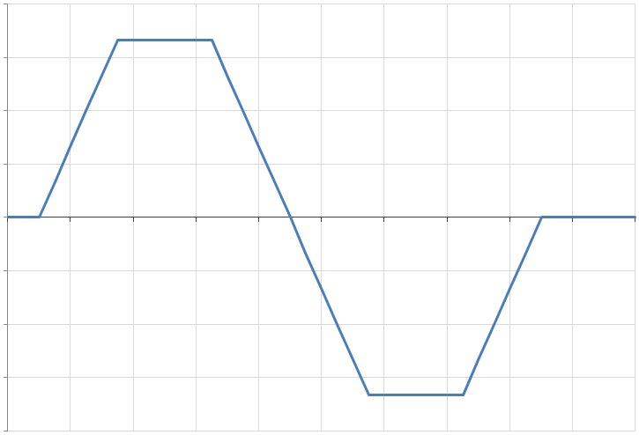
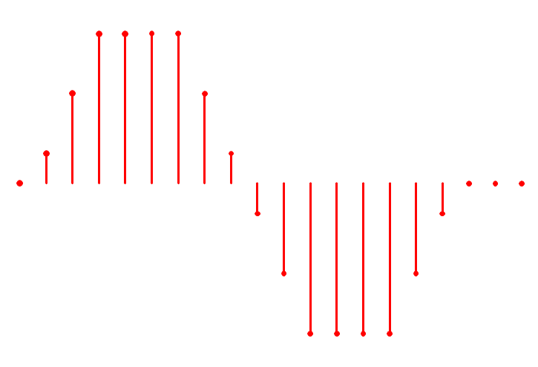
Real Time Sampling
Sine Wave:
  Single frequency
  Sampling rate > 2 x max. frequency
  'Nyquist-Theorem'
Pulse, Rectangular Waves
  Broadband
  Sampling rate > 10 x Max. frequency
Realistically:
  10-fold oversampling

Slide 14
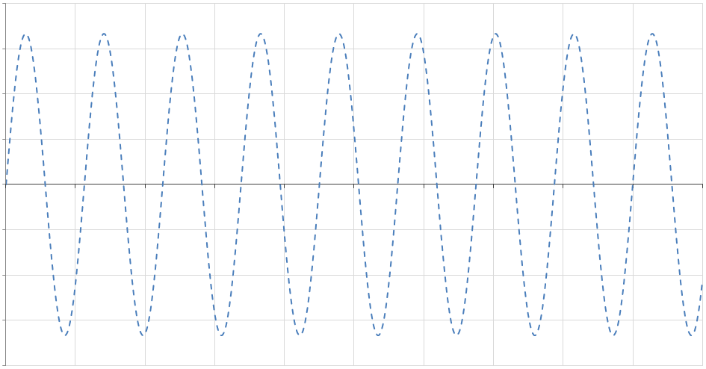
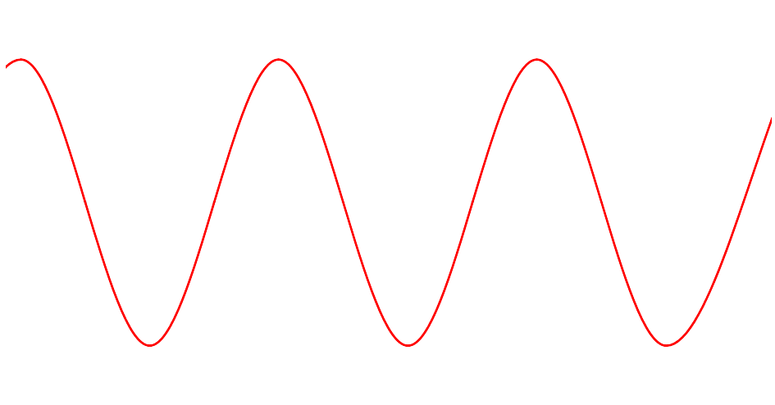
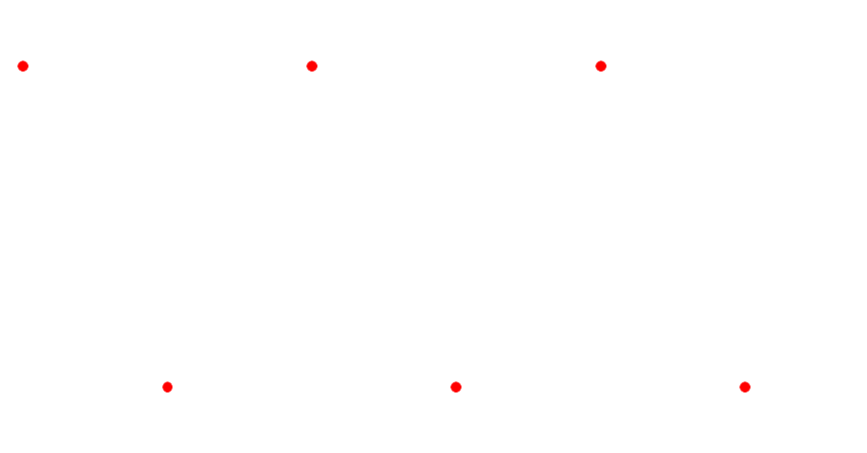
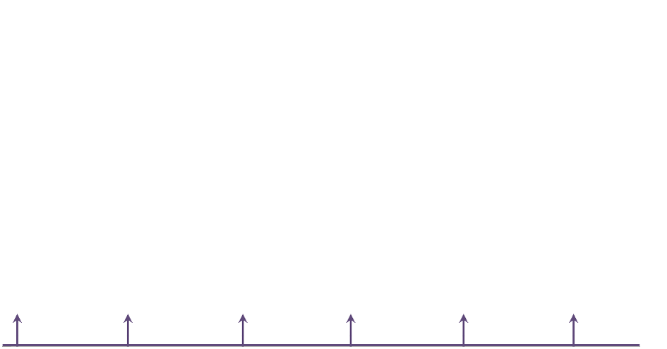
Aliasing
Reason: Sampling rate too low
Consequence: Frequency too low, wrong waveform, no trigger possible

Slide 15
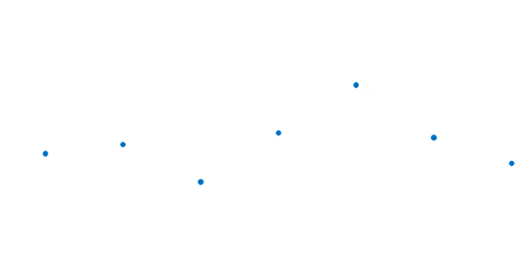

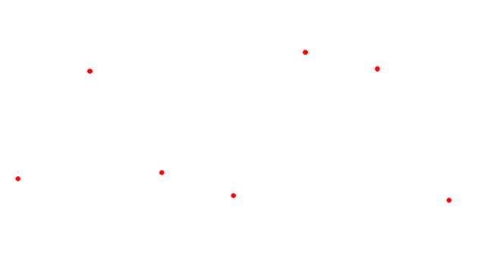
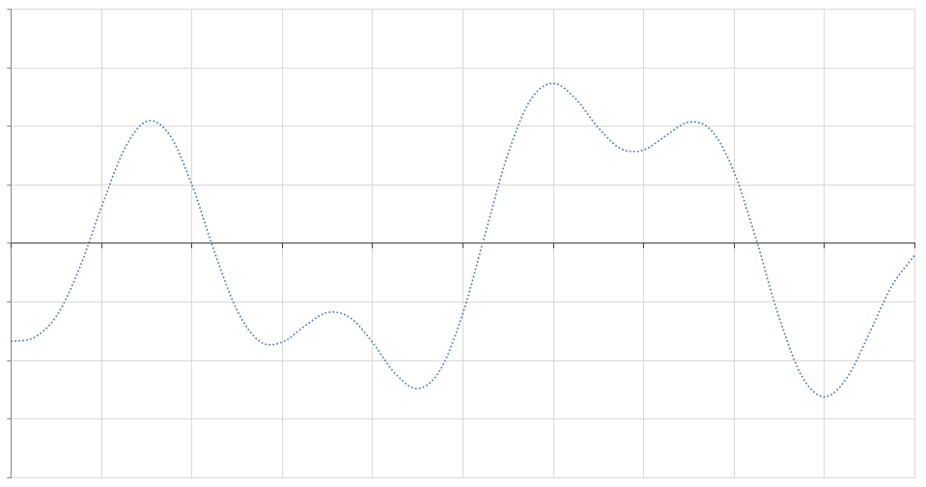

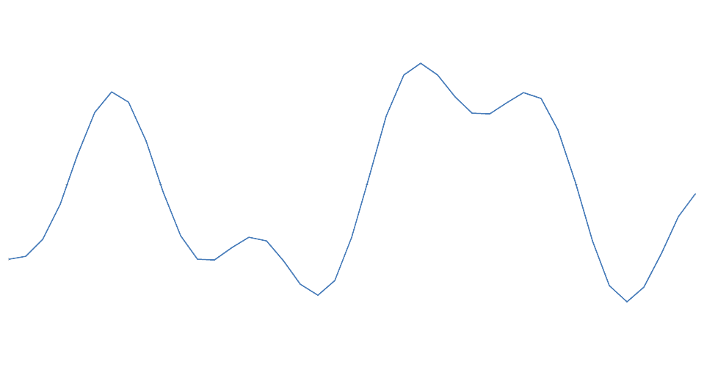
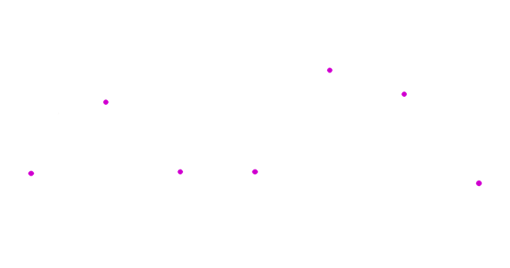
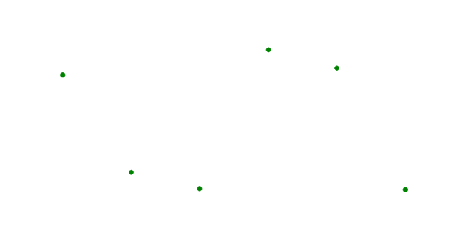
Multisampling (Random Interleaved Sampling)
Multisampling of a signal ⇒ high effective sampling rate
For periodic signals with a stable trigger time only

Slide 16
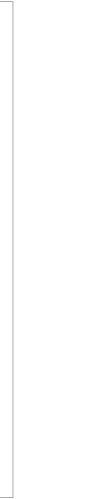
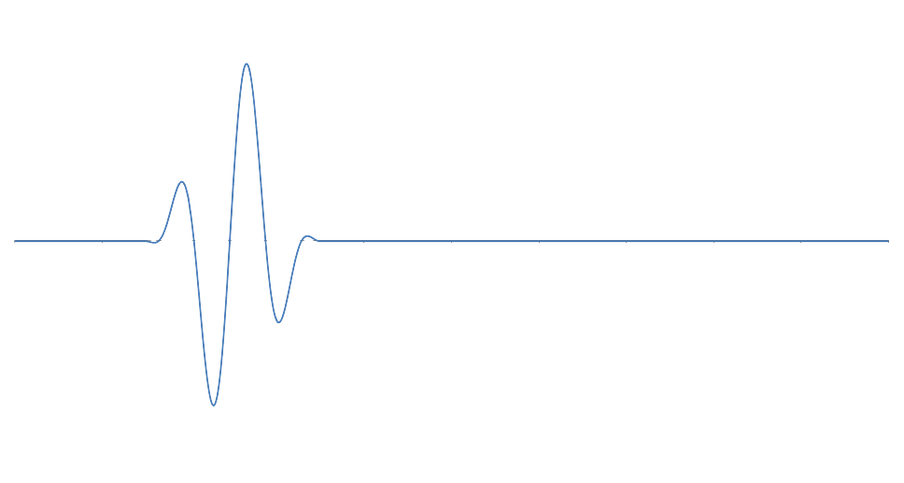

Sampling - Roll Mode
Display of slow processes (e.g. t ≥ 0.5 s/div)
The signal passes through the screen from right to left

Slide 17
Screen

Slide 18
Screen Display
Acquired Signals
  Direct Display
  Enlarged Display (Zoom, Sections)
  Calculated Signals (Mathematical Combinations)
  FFT Display
Measurements
  Manual Cursor Readout
  Automated Parameter Measurements
  Statistics
Controls / Settings
  Horizontal / Vertical Scale
  Trigger Settings
  Channel Menu

Slide 19
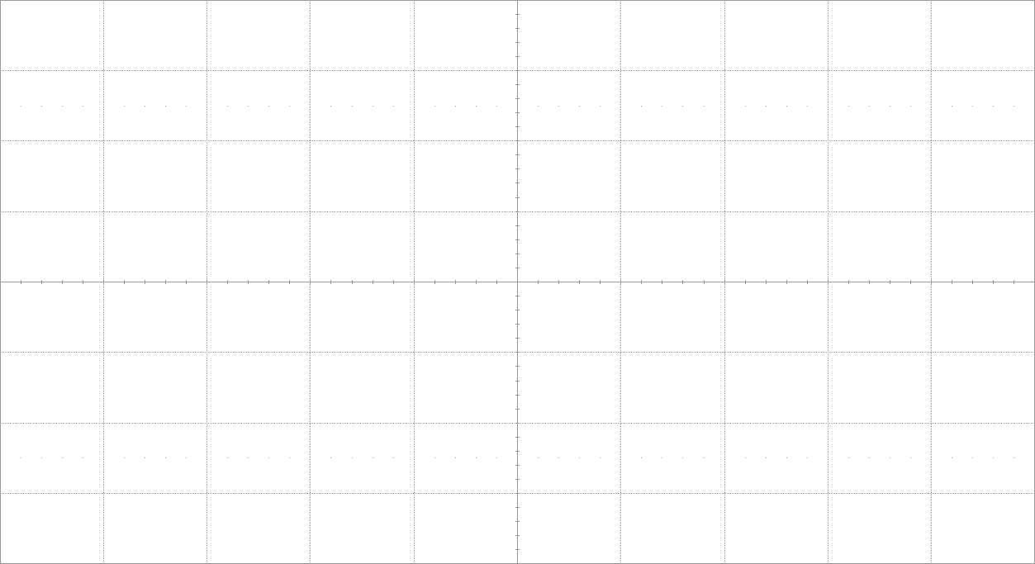
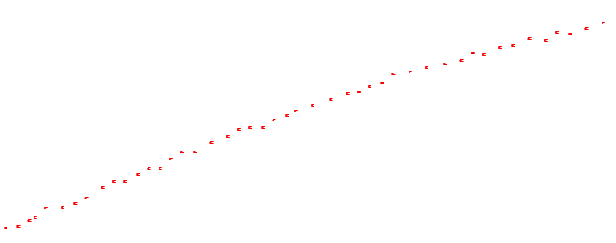
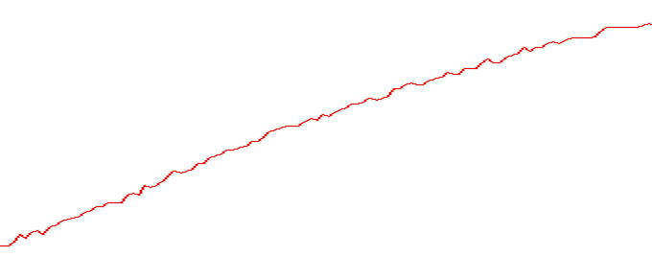
Screen Display
Display of the Sampling Points or Interpolated Waves
Measured Points
  sampling points, not connected
Interpolated Display
  Linear or Sin x/x connected

Slide 20

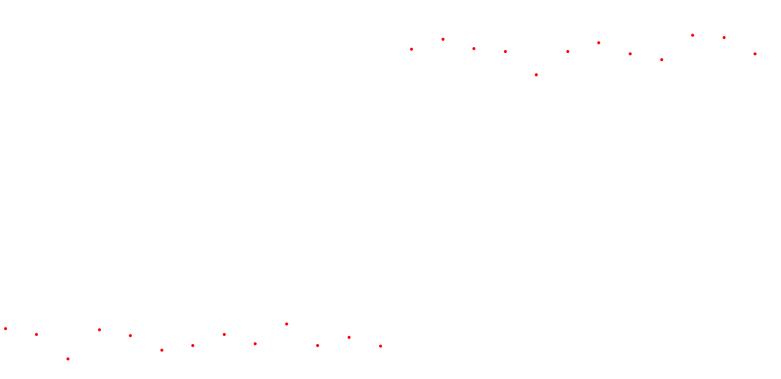
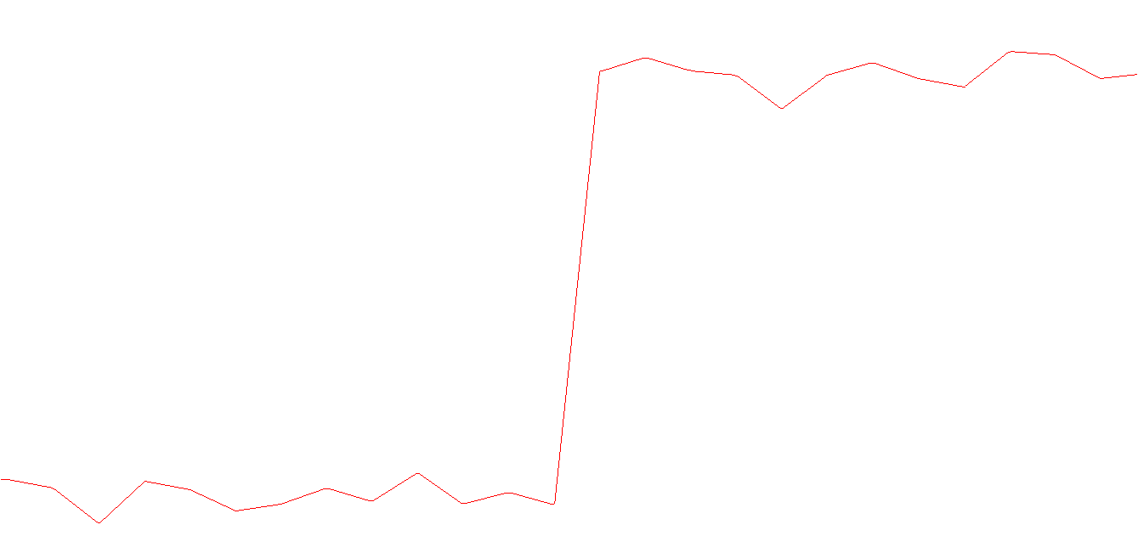
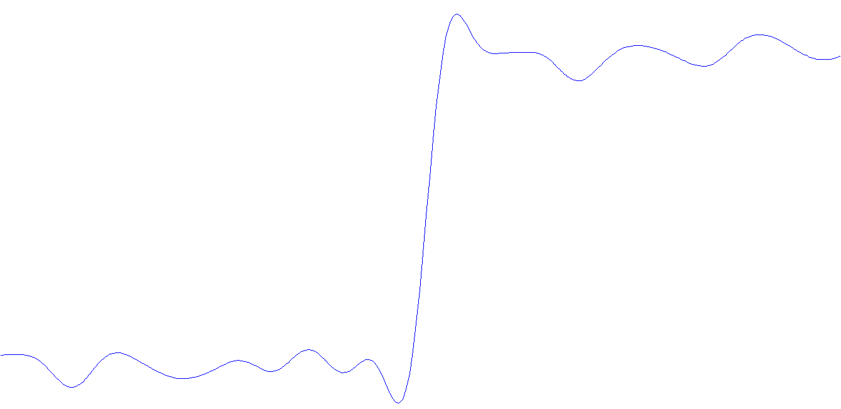
Screen Display
Comparison of Linear Connection and sin (x)/x Interpolation

Slide 21
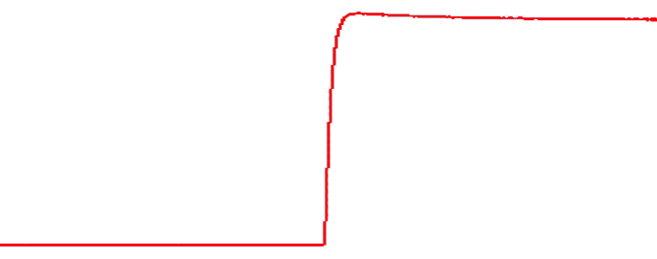
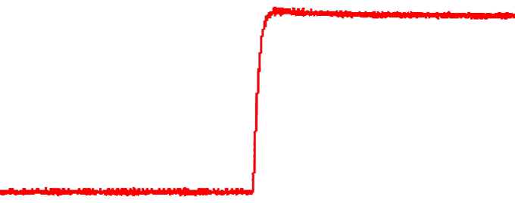
Screen Display
Averaging of Measurement Data
Raw Data
  Display of all points
Averaged Representation
  ‘Clean‘ Signal (?)

Slide 22
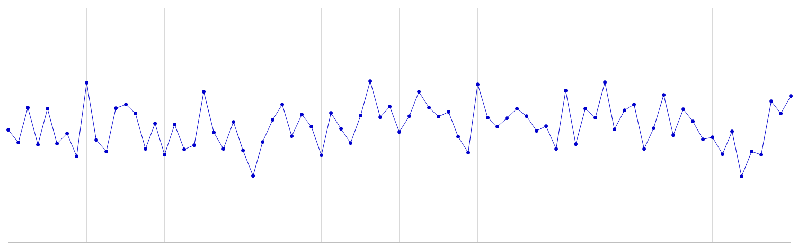
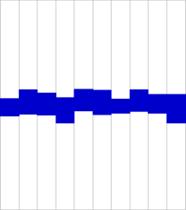
Screen Display
Data reduction for display ⇒ max/min display
1 Million Data Points
  Grouping of the raw data
  Determine of max/min values
  Display the max/min values in the form of a vertical bar in the screen columns
  'Visual noise' by displaying all acquired data points
1'000 Screen Columns

Slide 23
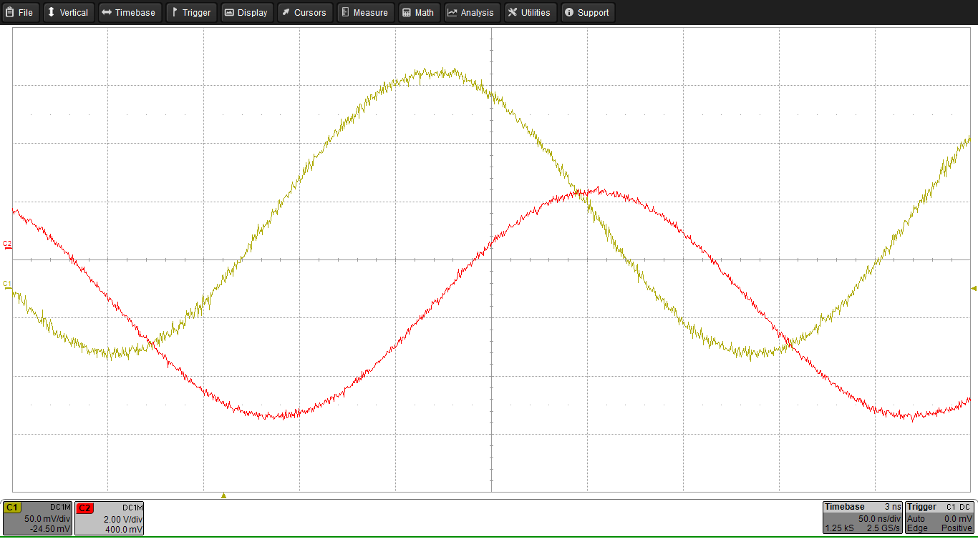
Screen Display – Signals
  Menu
  Signals
  Ground
  Time Base / Trigger
  Channel
  Info

Slide 24
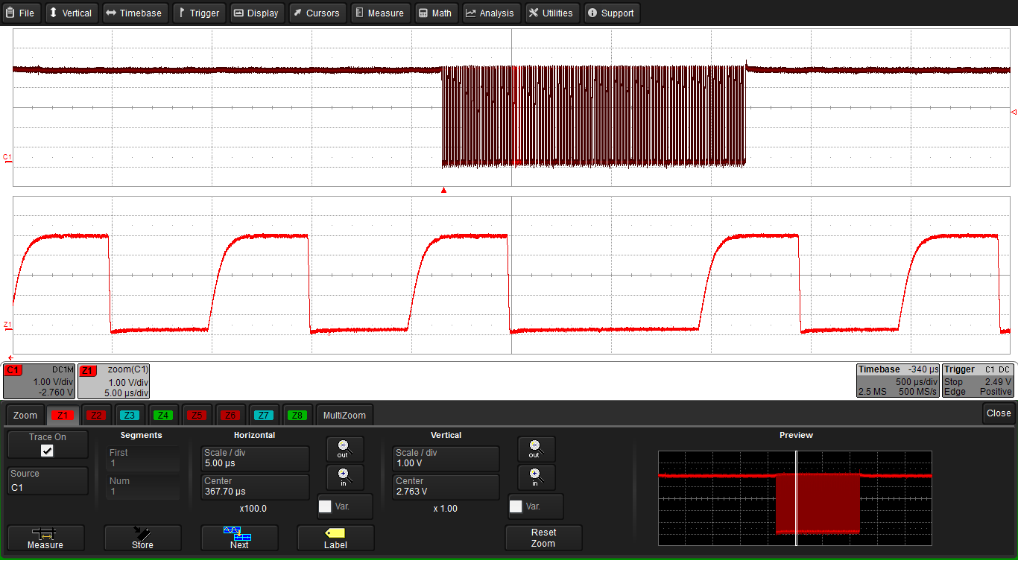
Screen Display – Zoom
  Original
  Zoom
  Settings
  Preview

Slide 25
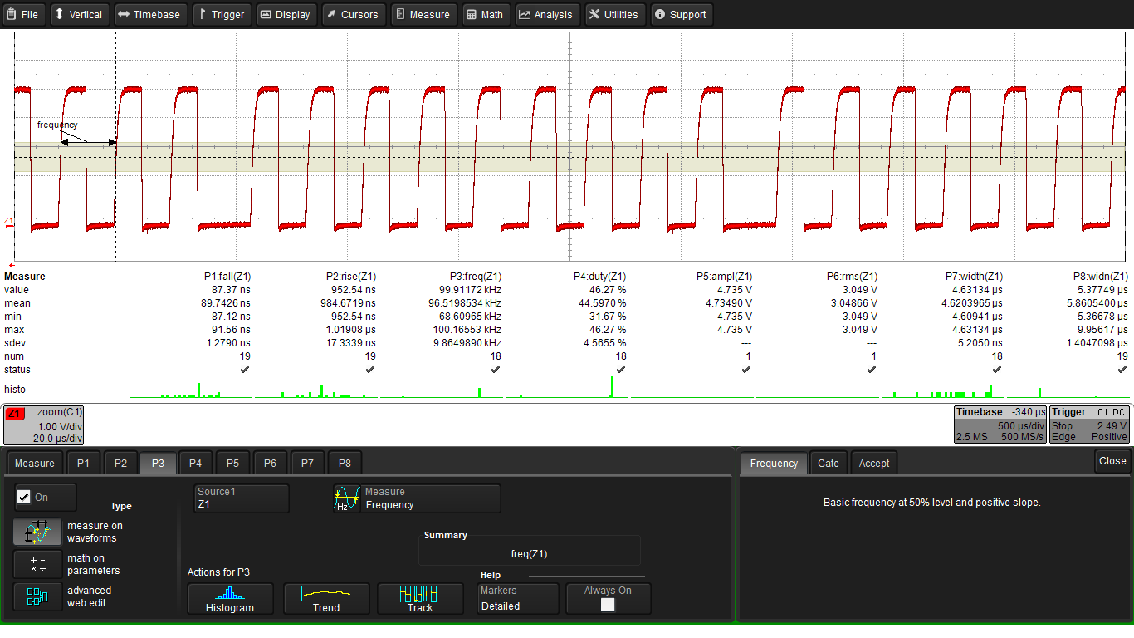
Screen Display – Parameter Measurement
  Signal
  Parameter
  w/ Statistics
  & Histicons
  Settings

Slide 26
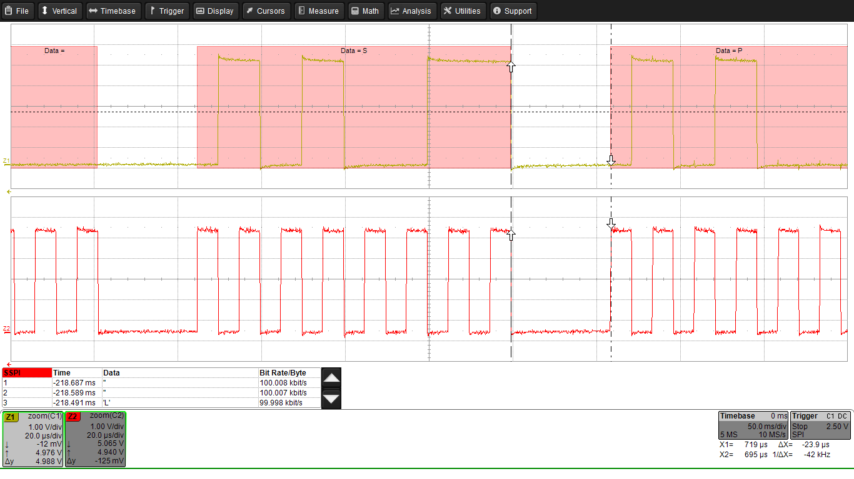
Screen Display – Cursor Readouts
  Cursors
  Horizontal Values
  Vertical Values

Slide 27
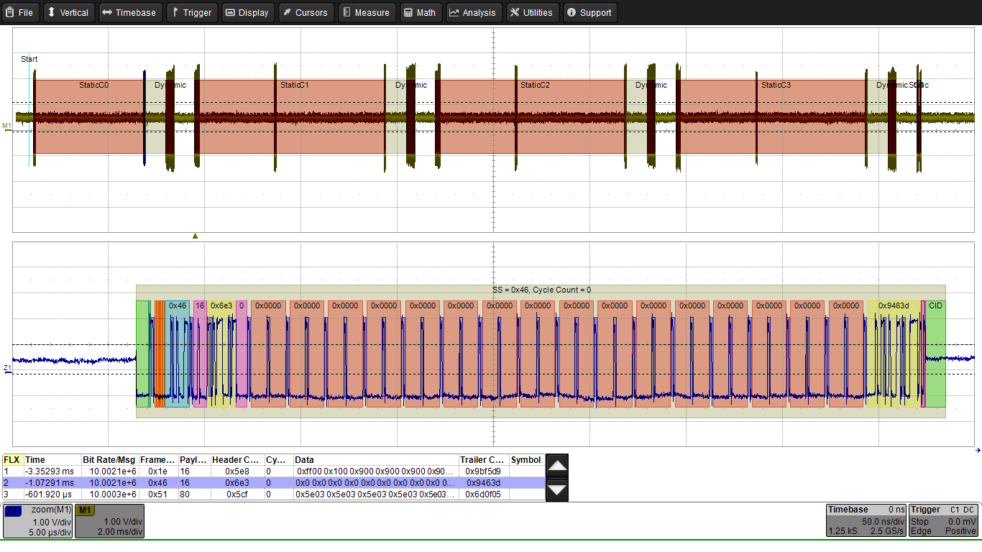
Screen Display – Serial Bus Decoder
  Original
  Signal
  Decoded Contents with Color Overlay
  Table with Values

Slide 28
Trigger

Slide 29

Trigger – Overview
Start of Acquisition for Single Events
Synchronizing the Acquisition ⇒ Stable Image
Trigger Modes
  AUTO Trigger: continuous triggering on internal time base
  NORMAL Trigger: continuous triggering on defined event
  (edge, pulse width, logic, smart, …)
  SINGLE Trigger: single triggering on defined event
  (edge, pulse width, logic, smart, TV, …)
Trigger Sources:
  Analog Channels 1-4
  Digital Channels
  External Trigger Input

Slide 30
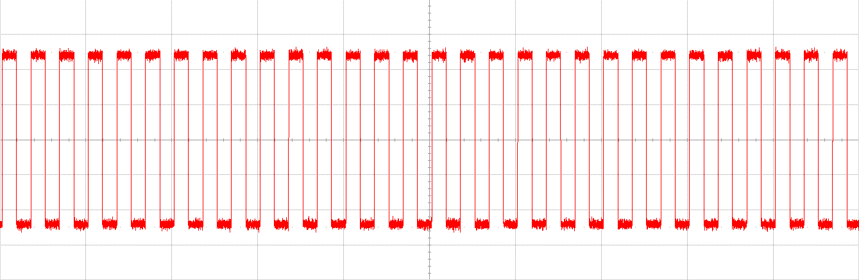
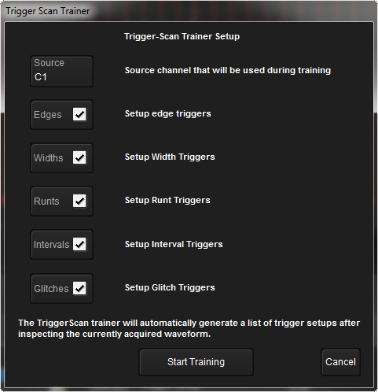
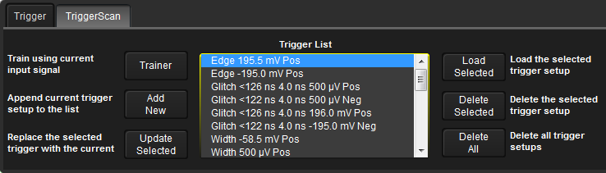
TriggerScan Function
TriggerScan automatically scans the signal for possible triggers
Selection of search criteria
Trigger setting through selection
from the compiled list

Slide 31







Triggering – Standard Triggers
Trigger | Description
 | 'Edge', trigger on positive, negative, or both signal edges
 | Trigger on positive edge
 | Trigger on negative edge
 | Trigger on alternative edges
 | 'Parameter': Trigger on various measurement parameters
 | 'Pulse width': Trigger on positive/negative pulse, defined width/height
 | 'TV Trigger' (PAL, SECAM, NTSC, HDTV 1080i/1080p/720p)

Slide 32








Triggering – Extended Triggers
Trigger | Description
 | 'Multi-stage Trigger': Event 'A' dependent on 'B' dependent on …
⇒ | 'Interval': Trigger on distance between two same sense edges
⇒ | 'Dropout': Trigger on lack of trigger event within a certain time frame
⇒ | 'Runt': Trigger on reduced positive/negative pulses
⇒ | 'Edge Slope': Trigger when slope outside of definition
⇒ | 'Glitch': Trigger on defined pulse width independent of height
⇒ | 'Window': Trigger when the signal leaves the defined window

Slide 33






Triggering – Digital Triggers
Trigger | Description
 | 'Digital Pattern': High/Low von CH1, CH2, CH3, CH4 und EXT
⇒ | Logical AND
⇒ | Logical NAND
⇒ | Logical OR
⇒ | Logical NOR
 | Serial Bus Trigger for various protocols

Slide 34


















Triggering – Serial Bus Triggers
Trigger | Description
 | Serial Trigger SPI
 | Serial Trigger I²C
 | Serial Trigger RS-232 / UART
 | Serial Trigger MIL-1553-STD
 | Serial Trigger CAN / CAN FD
 | Serial Trigger LIN
 | Serial Trigger FlexRay
 | Serial Trigger I²S (Audio)
 | Serial Trigger USB

Slide 35
Polling Question #2
Do You Know And/Or Use These Triggers?
  Slope: Rise/Fall Time Trigger
  Dropout Trigger
  Digital/Logical Trigger Also For Analog Signals
  Serial Data Trigger

Slide 36
Measurements

Slide 37
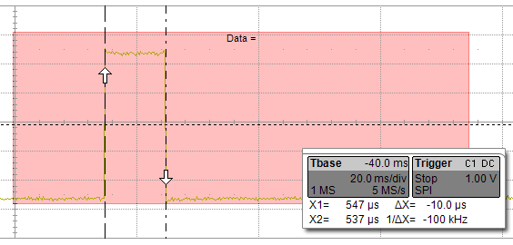
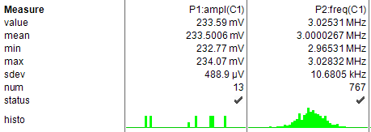
Measurements
Two Measurement Methods:
  Manual cursor readouts
  Automated parameter measurements
Cursor Readouts
  Fast check of all visible points
  Screen resolution only
Parameter Measurements
  Setting of the parameter and/or measurement window
  Full internal resolution
  Statistics

Slide 38
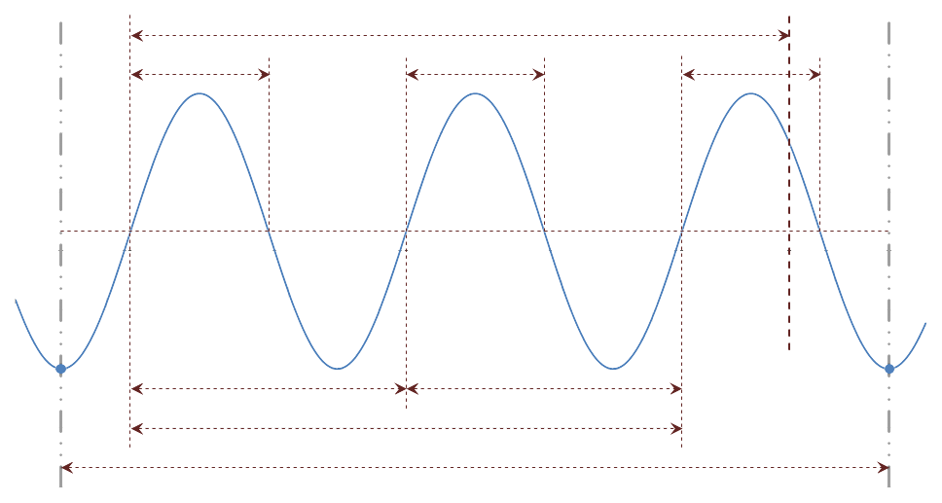
Measurements – Definition of Horizontal Parameters
Delay
Pulse Width
Pulse Width
Pulse Width
Average
(50% Amplitude)
Trigger Time
Period
Period
First Point
Frequency = 1/Period
Last Point
Frequency = 1/Period
2 Full Periods
Data Area for Surface and Point Calculations, etc.
Left Cursor
Right Cursor

Slide 39

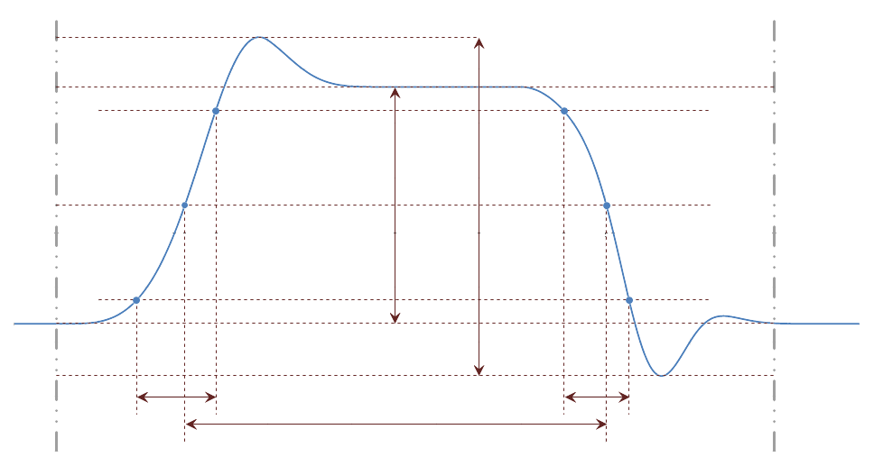
Measurements – Definition of Vertical Parameters
Maximum
Top
Upper Limit
(90% Amplitude)
Peak/Peak
Average
(50% Amplitude)
Histogram for Top/Base Identification
Amplitude
Lower Limit (10% Amplitude)
Base
Minimum
Rise Time
Fall Time
Pulse Width
Measurement Window, Left Limit
Measurement Window, Right Limit

Slide 40
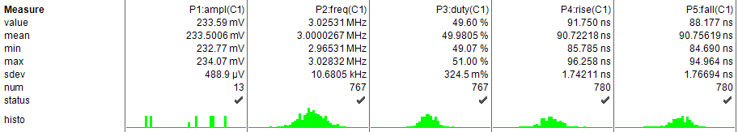
Measurements - Parameters & Statistics
Automated Online Measurement
Use of the Entire Memory for the Online Parameter Measurement
Display of Statistical Values
'Histicons' to visualize the statistics
Parameters can be used for WaveScan

Slide 41

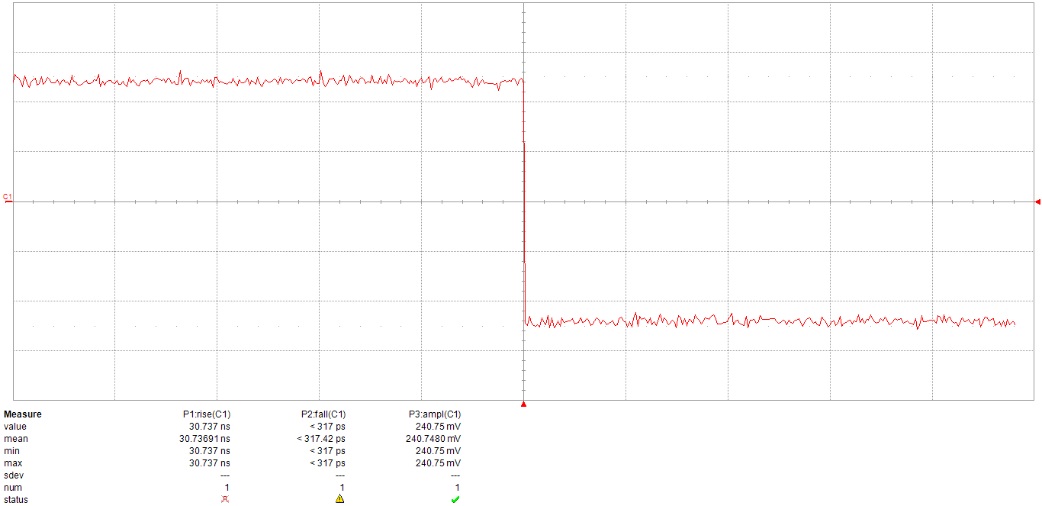
Measurements – Parameter Qualification
Qualification of parameters to indicate whether the respective measurement is correct
  'Rise Time': no value due to lack of rising edges
  'Fall Time': possible, but not enough values available on the edge
  'Amplitude': correct measurement

Slide 42
Polling Question #3
Do You Know/Use Parameter Measurements?
  On A Regular Basis
  Occasionally
  I Prefer Cursor Measurements

Slide 43
Mathematics

Slide 44
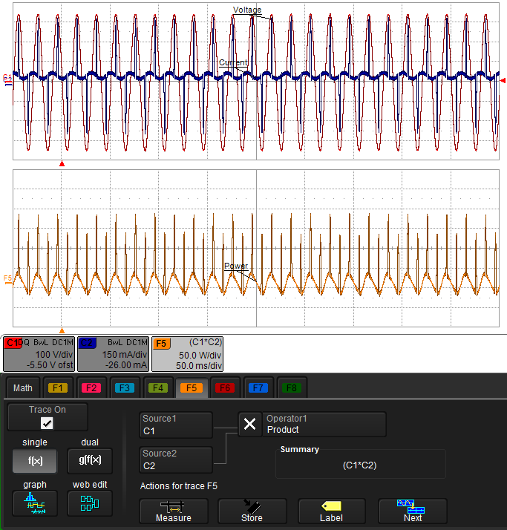
Mathematics
Conversion of Individual Channels
  e.g. inverting, re-scaling, etc.
Mathematical Combination of Channels
  e.g. 'C1 * C2'
Cascaded Mathematics: f(g(x))
Free definition of customized functions
FFT (Fast Fourier Transformation)

Slide 45
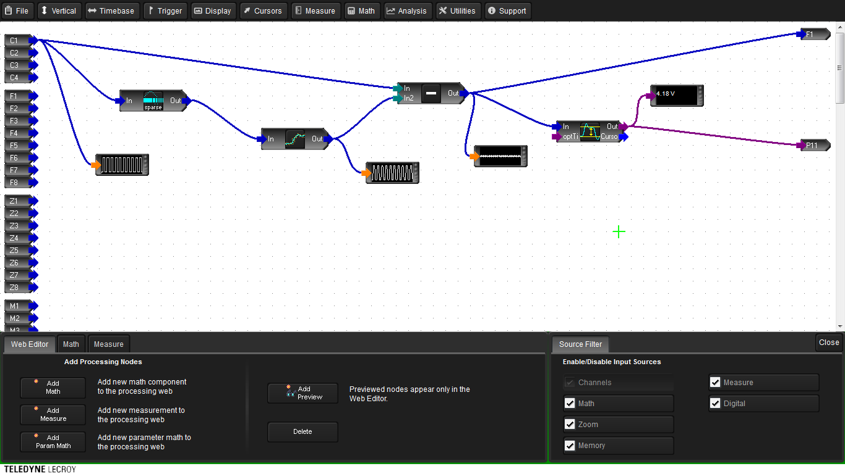
Mathematics – Customized Functions / WebEdit

Slide 46
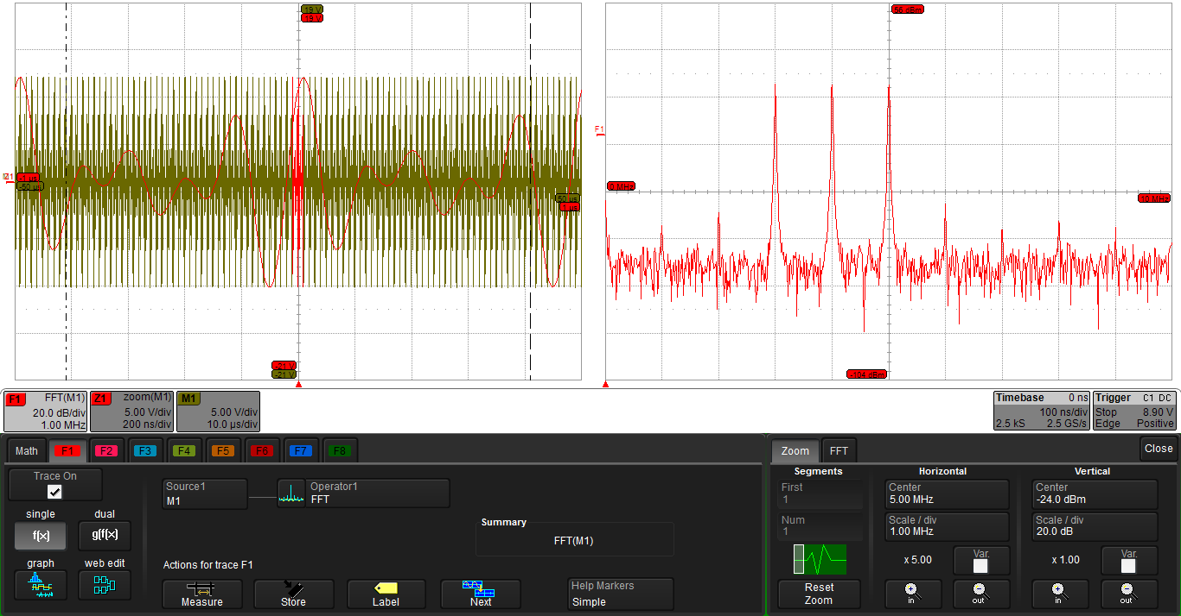
Mathematics – Fast Fourier Transformation FFT

Slide 47
WaveScan – Automated Signal Monitoring

Slide 48
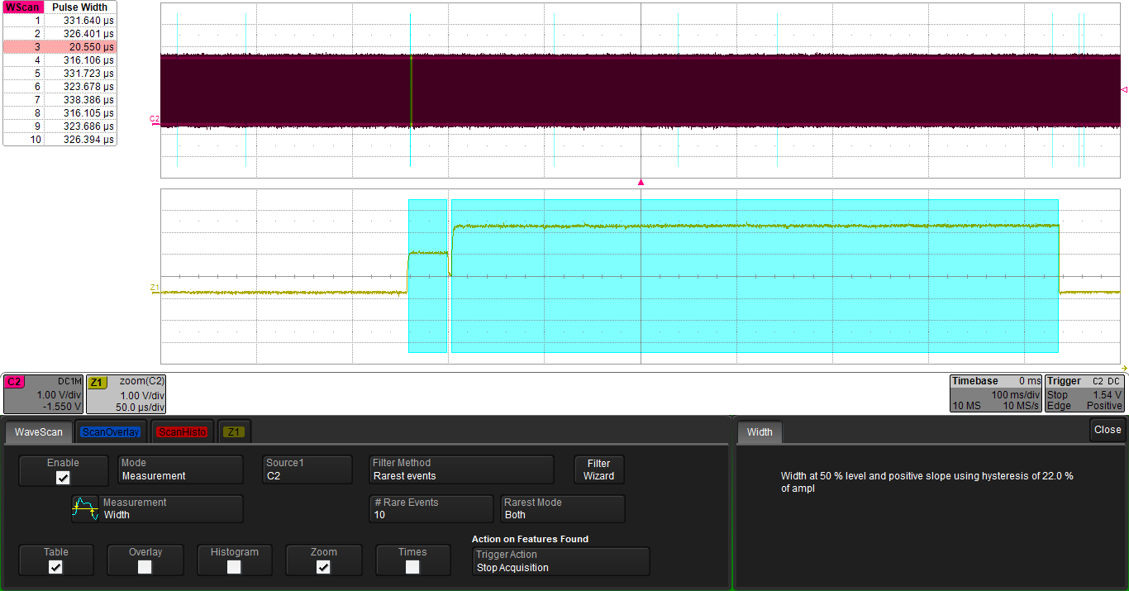
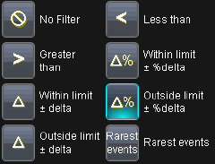
WaveScan – Automated Signal Monitoring
Automated Signal Scan
Parameter Monitoring
Search for:
  Runts
  Non-Monotony
  Serial Patterns / Bus
Filter Functions:
  Rarest Events
  Maximum / Minimum
  Within / Outside of Limits, Delta %
Automatic Documentation

Slide 49

WaveScan – Table of Events
Table with list of found events
Highlighting of the events in the original signal
Selection of a specific event by clicking on the respective table entry
Enlarged display of events

Slide 50

WaveScan – Search for Digital Patterns
Finding sequences in a digital signal
Display of binary or hexadecimal code
Definition of the sequence to be searched
Table with detected events

Slide 51
LabNotebook - Documentation

Slide 52


LabNotebook – Documentation, Storage
Storing of
  the Screen Display
  the Oscilloscope Settings
  the Measured Data of a Channel
  EVERYTHING! ⇒ LabNotebook
Saving on
  Internal Memory (Limited)
  Integrated Hard Drive
  External Storage Media (USB
  Drives, etc.)
⇒ Archiving / Further Processing

Slide 53

LabNotebook – 'Flashback Function'
Reloading of saved Measurements & Settings
②
①
③
Selection of desired LabNotebook archive
Selection of desired entry
Reloading of all data: Analog/Digital Channels, Zoom, Mathematics, Cursor, Parameters, … ⇒ Further analyses!

Slide 54

LabNotebook – Offline Display Using WaveStudio

Slide 55

LabNotebook – Offline Processing Using WaveStudio

Slide 56


LabNotebook – Documentation, Reports
Saving setups and all data with a single touch of a button
'Flashback' Function ⇒ Retrieving all data and settings of an entry
Report Function ⇒ Generating PDF, HTML or RTF reports of the measurement
Emailing the report directly from the oscilloscope

Slide 57


Questions & Answers
Use the Questions section of the
GotoWebinar control panel
Or send your question by email to
jens.scheuren@teledynelecroy.com

Slide 58
Thank You
For Your Kind Attention.
Teledyne LeCroy GmbH - Tel. +49 (6221) 8270-0 - contact.gmbh@teledynelecroy.com

